Slide 1
Capstone Project
Hotel Booking Analysis By Akash raj Data Science Trainee, AlmaBetter

Slide 2
WHY ANALYZE THE HOTEL BOOKIG ANALYSIS
This makes analyzing the patterns available in the past data more important to help the hotels plan better.

Slide 3
Agenda
1) Which type of hotel is mostly prefered by the guests?
2)What is the percentage of cancellation?
3) What is the Percentage of repeated guests?
4) What is the percentage distribution of "Customer Type"?
5)What is the percentage distribution of required_car_parking_spaces?
6)What is Percentage distribution of Deposit type ?
7) Which type of food is mostly preferred by the guests?
8) From which country the most guests are coming?
9) Which is the most preferred room type by the customers?
10)In which month most of the bookings happened?
11) Which Distribution channel is mostly used for hotel bookings?
12) Which year had the highest bookings?

Slide 4
Dataset Preparation
Loading the data sets : - Hotel booking
Importing Essential Libraries : - NumPy, Pandas, Seaborn and Matplotlib
Data Cleaning: - Null values, Finding and removing Outliers, Removing duplicate data.
EDA (Exploratory Data Analysis) : - Analyzing the data sets to summarize their main characteristics using statistical graphics and data visualizations method.

Slide 5
OVERVIEW OF ANALYSIS
Data Collection and Understanding
Data Cleaning and Manipulation
Exploratory Data Analysis(EDA)

Slide 6
Data Collection and Understanding .
1. hotel :- Hotel(Resort Hotel or City Hotel)
2. is_canceled :-Value indicating if the booking was canceled (1) or not (0)
3. lead_time :- Number of days that elapsed between the entering date of the booking into the PMS and the arrival date
4. arrival_date_year :- Year of arrival date
5. arrival_date_month :- Month of arrival date
6. arrival_date_week_number :- Week number of year for arrival date
7. arrival_date_day_of_month :- Day of arrival date
8. stays_in_weekend_nights :- Number of weekend nights (Saturday or Sunday) the guest stayed or booked to stay at the hotel
9. stays_in_week_nights :- Number of week nights (Monday to Friday) the guest stayed or booked to stay at the hotel
10. adults :- Number of adults

Slide 7
11. children :- Number of children
12. babies :- Number of babies
13. meal :- Type of meal booked. Categories are presented in standard hospitality meal packages:*
14. country :- Country of origin.`
15. market_segment : -Market segment designation. In categories, the term “TA” means “Travel Agents” and “TO” means “Tour Operators”
16. distribution_channel :- Booking distribution channel. The term “TA” means “Travel Agents” and “TO” means “Tour Operators”
17. is_repeated_guest : -Value indicating if the booking name was from a repeated guest (1) or not (0)*
18. previous_cancellations :- Number of previous bookings that were cancelled by the customer prior to the current booking*
19. previous_bookings_not_canceled :-Number of previous bookings not cancelled by the customer prior to the current booking*
20. reserved_room_type :- Code of room type reserved. Code is presented instead of designation for anonymity reasons.*

Slide 8
21. **assigned_room_type** : *Code for the type of room assigned to the booking.*
22. **booking_changes** : *Number of changes/amendments made to the booking from the moment the booking was entered on the PMS until the moment of check-in or cancellation*
23. **deposit_type** : *Indication on if the customer made a deposit to guarantee the booking.*
24. **agent** : *ID of the travel agency that made the booking*
25. **company** : *ID of the company/entity that made the booking or responsible for paying the booking.*
26. **days_in_waiting_list** : *Number of days the booking was in the waiting list before it was confirmed to the customer*
27. **customer_type** : *Type of booking, assuming one of four categories*

Slide 9
28. **adr** : *Average Daily Rate as defined by dividing the sum of all lodging transactions by the total number of staying nights*
29. **required_car_parking_spaces** : *Number of car parking spaces required by the customer*
30. **total_of_special_requests** :* Number of special requests made by the customer (e.g. twin bed or high floor)*
31. **reservation_status** : *Reservation last status, assuming one of three categories*
* Canceled – booking was canceled by the customer
* Check-Out – customer has checked in but already departed
* No-Show – customer did not check-in and did inform the hotel of the reason why
32. **reservation_status_date** : *Date at which the last status was set. This variable can be used in conjunction with the ReservationStatus
to understand when was the booking canceled or when did the customer checked-out of the hotel*

Slide 10
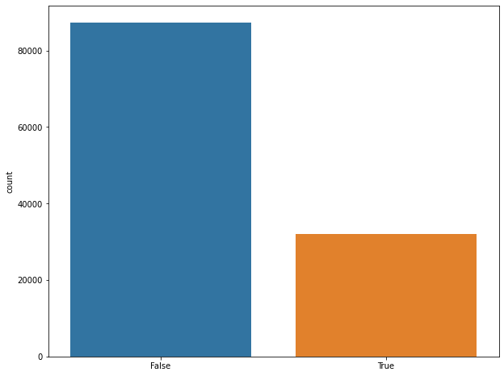
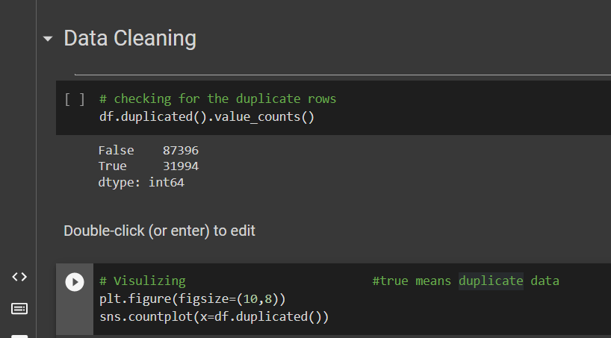
Data Cleaning

Slide 11
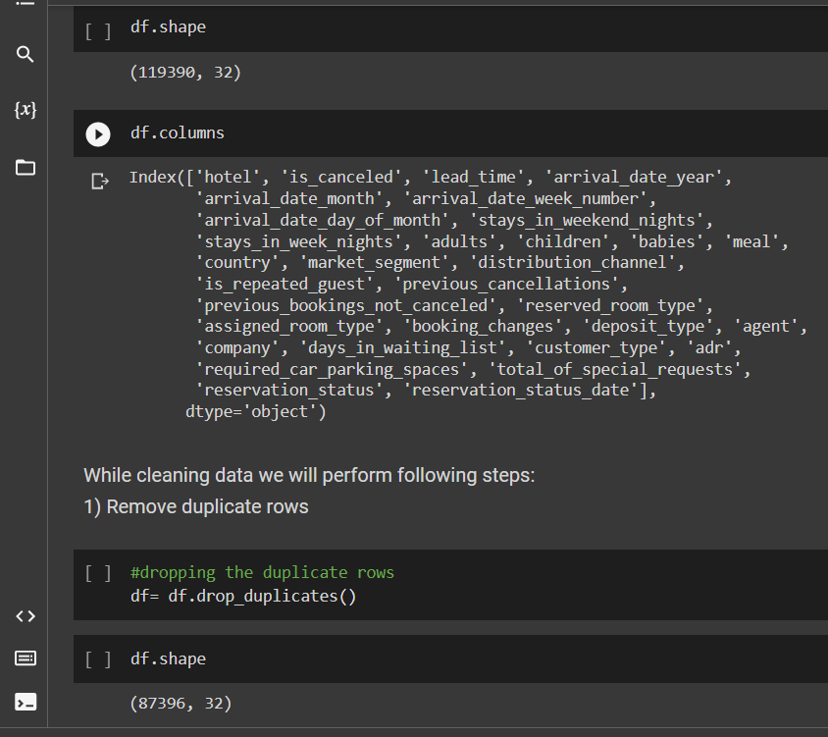
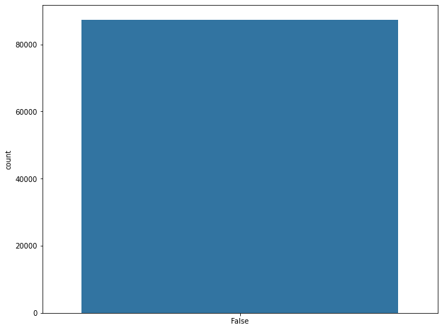

Slide 12
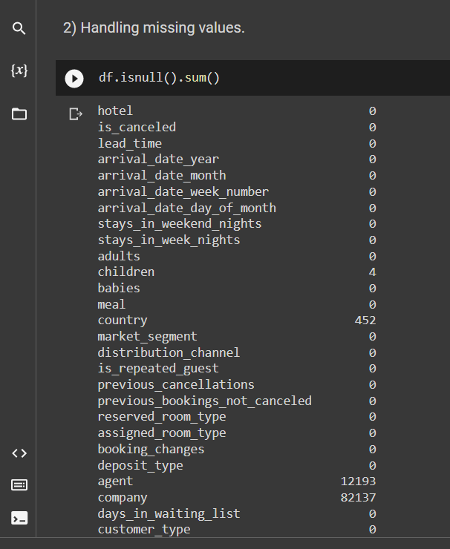
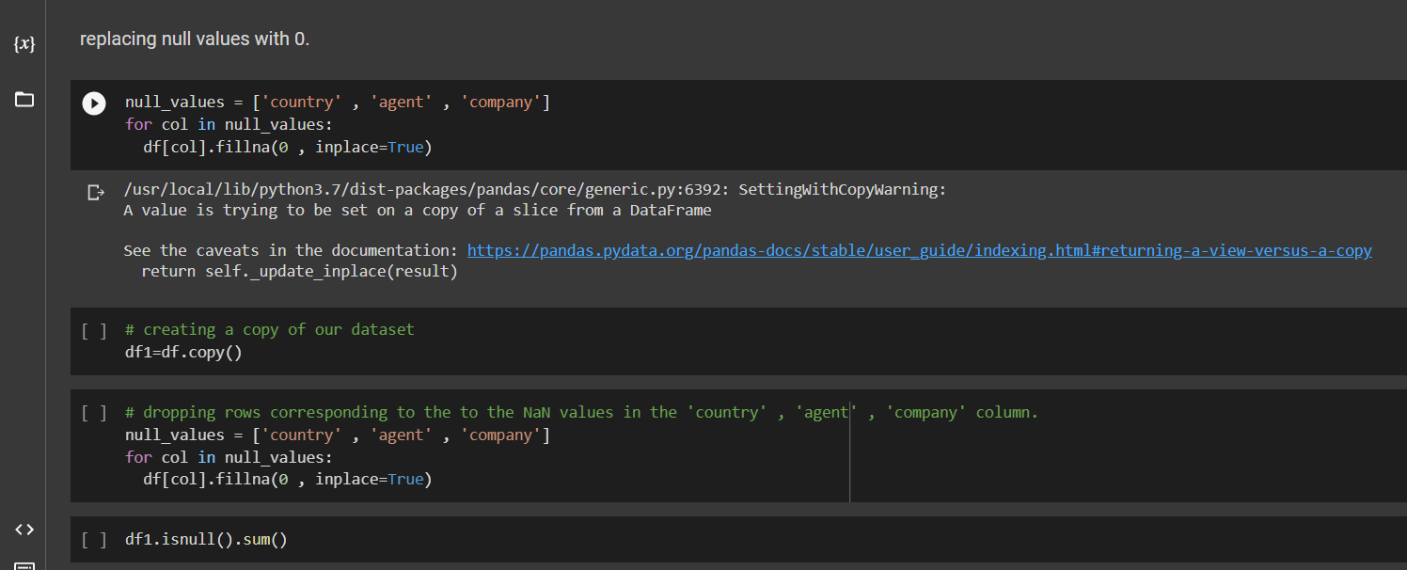
Finally handle the all null values

Slide 13
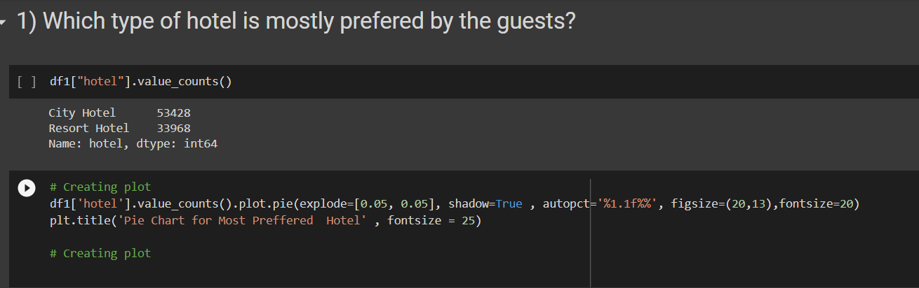
EDA (Exploratory Data Analysis)

Slide 14
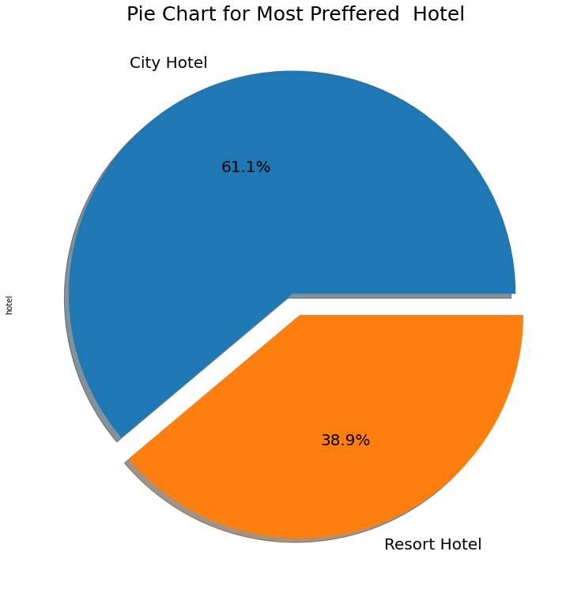
Observation
City Hotel is most preferred hotel by guests. Thus city hotels has maximum bookings.

Slide 15
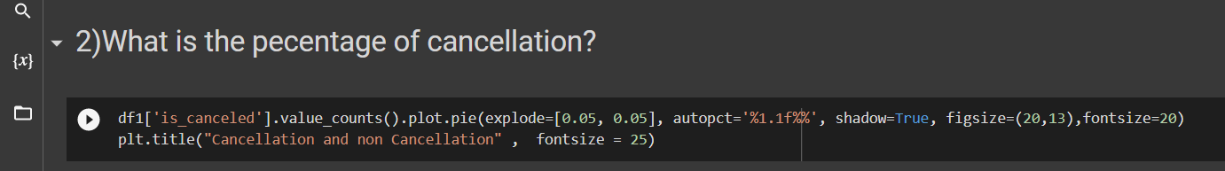
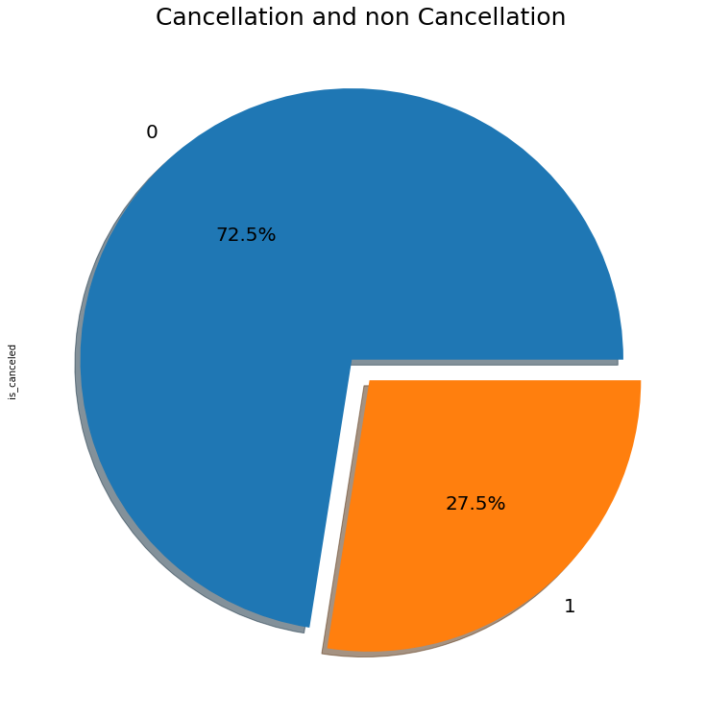
Observation
27.5 % of the bookings were cancelled

Slide 16
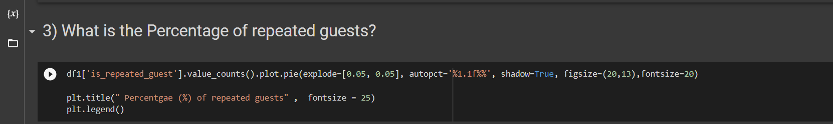
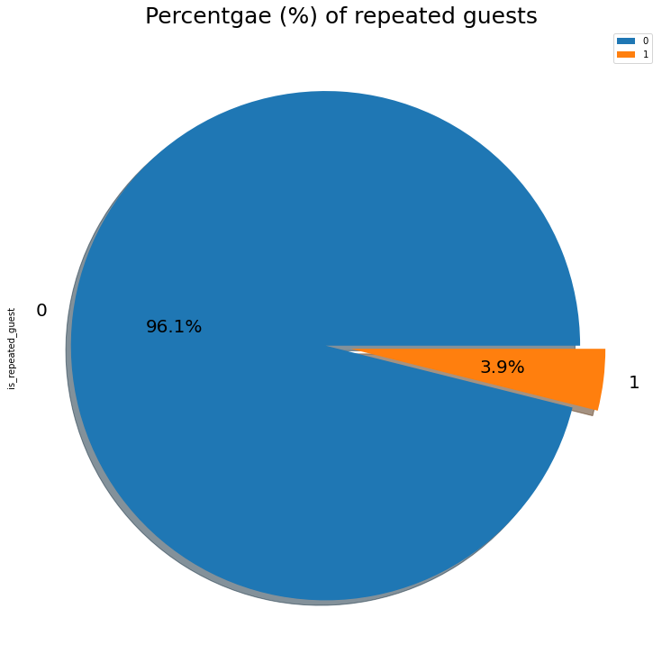
Observation:
Repeated guests are very few which only 3.9 %.
In order to retained the guests management should take feedbacks from guests and try to improve the services.

Slide 17
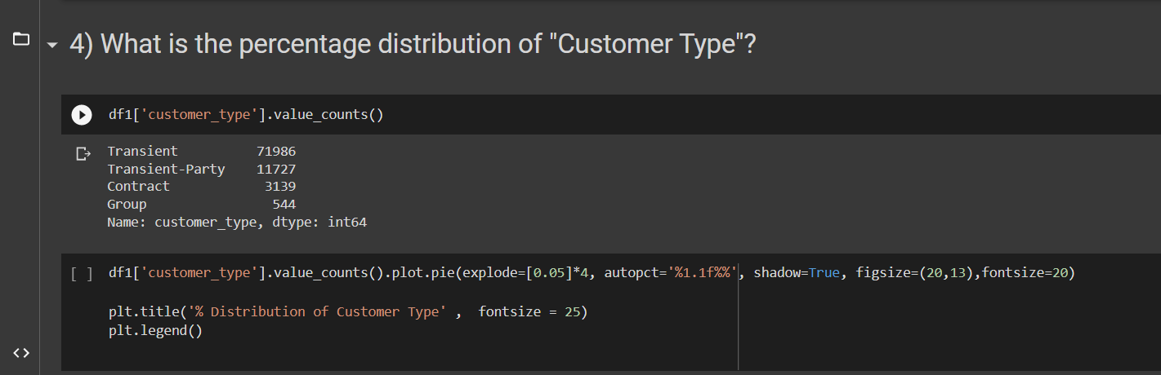
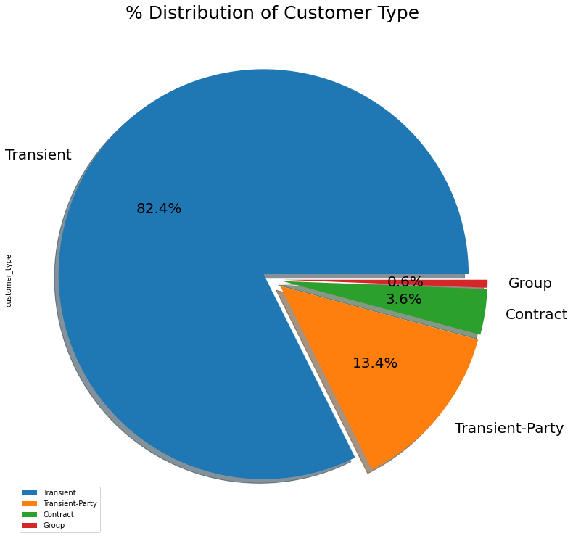
Observation:
Transient customer type is more which is 82.4 %. percentage of Booking associated by the Group is vey low.

Slide 18
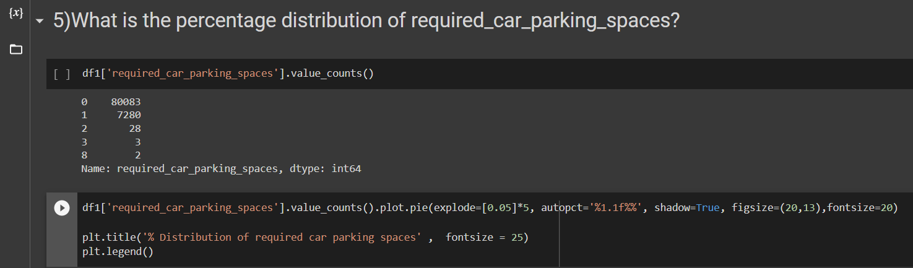
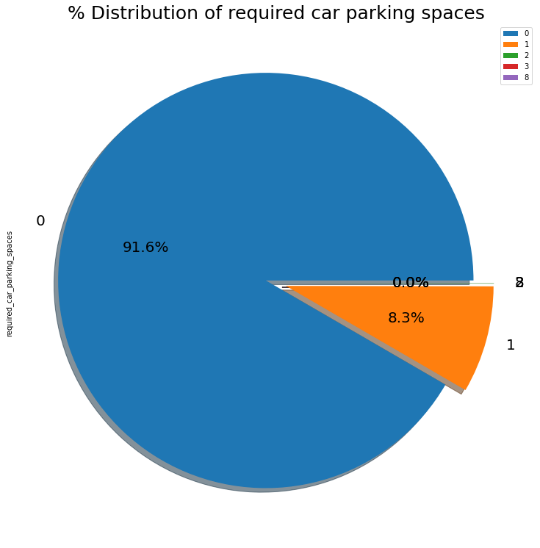
Observation
91.6 % guests did not required the parking space. only 8.3 % guests required only 1 parking space.

Slide 19
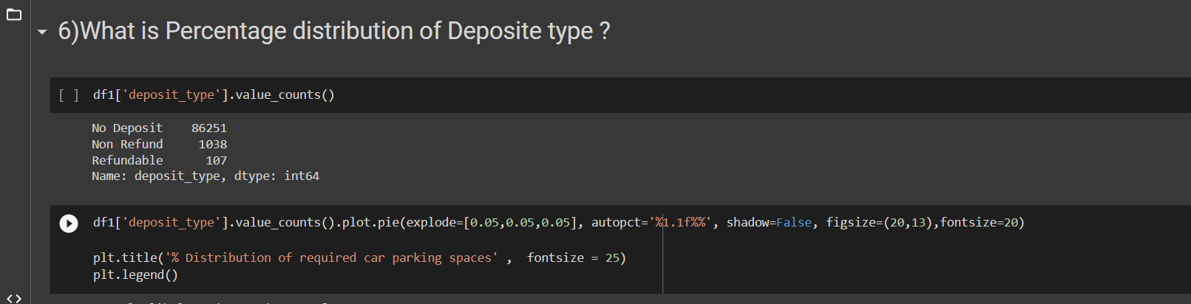
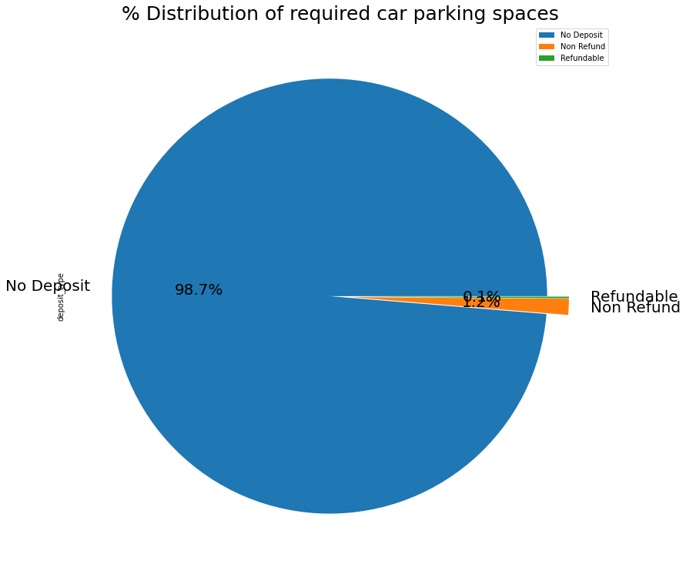

Slide 20
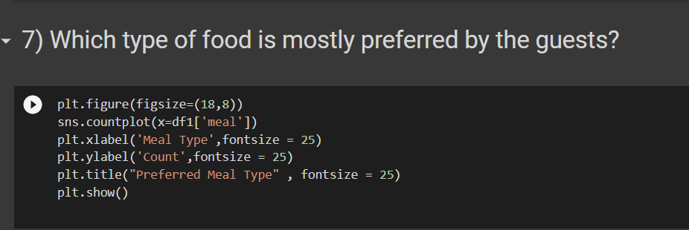
Types of meal in hotels:
BB - (Bed and Breakfast)
HB- (Half Board)
FB- (Full Board)
SC- (Self Catering)
Observation
* So the most preferred meal type by the guests is BB( Bed and Breakfast)
* HB- (Half Board) and SC- (Self Catering) are equally preferred.

Slide 21
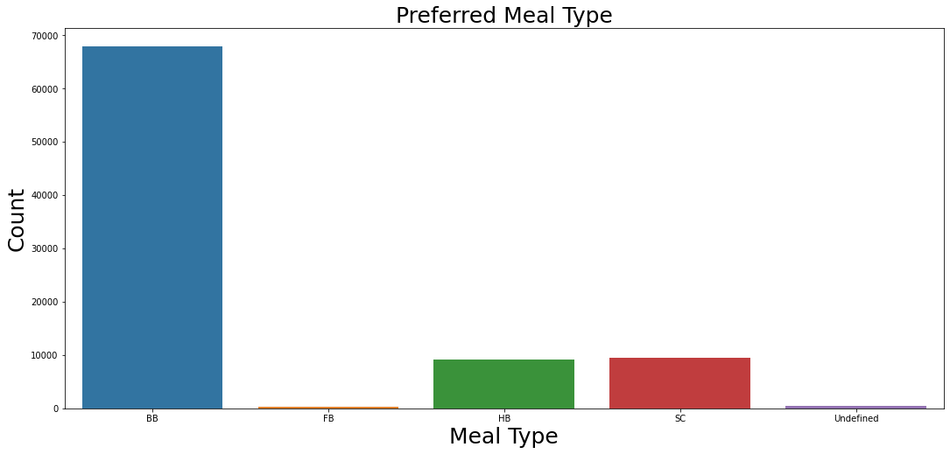

Slide 22
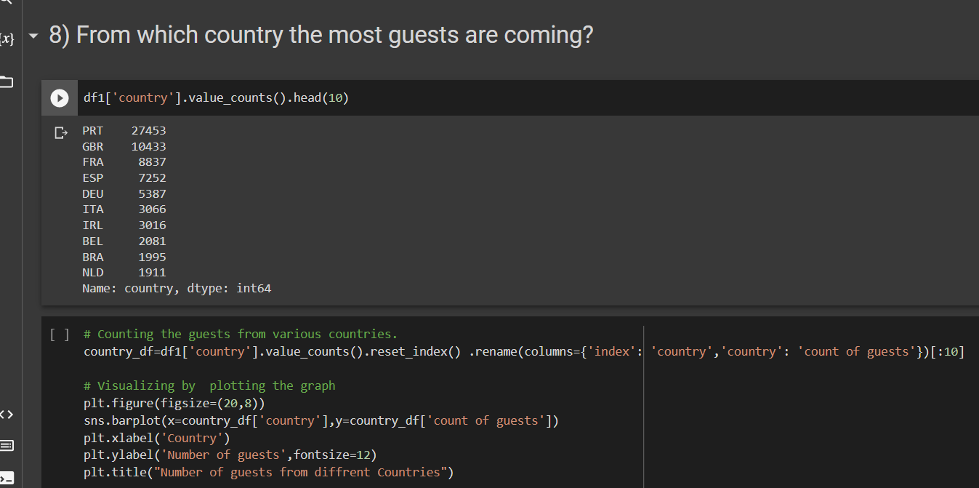

Slide 23
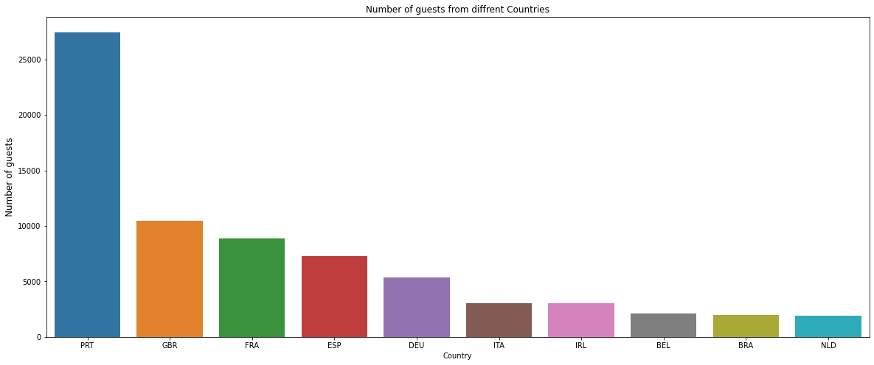
Observation
Most of the guests are coming from Portugal i.e more 25000 guests are from Portugal
abbreviations for countries-
PRT- Portugal
GBR- United Kingdom
FRA- France
ESP- Spain
DEU - Germany
ITA -Italy
IRL - Ireland
BEL -Belgium
BRA -Brazil
NLD-Netherlands

Slide 24
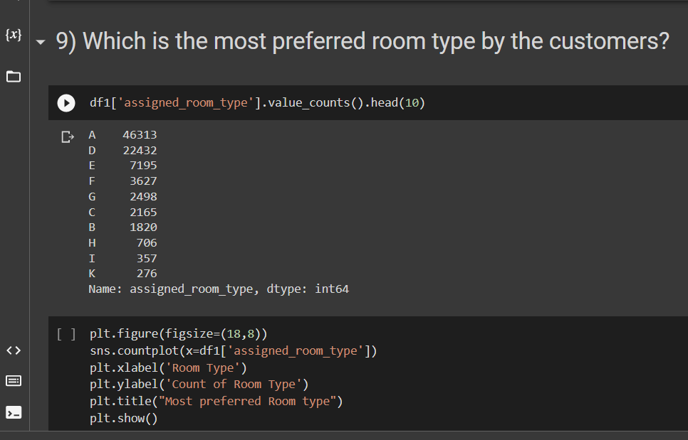
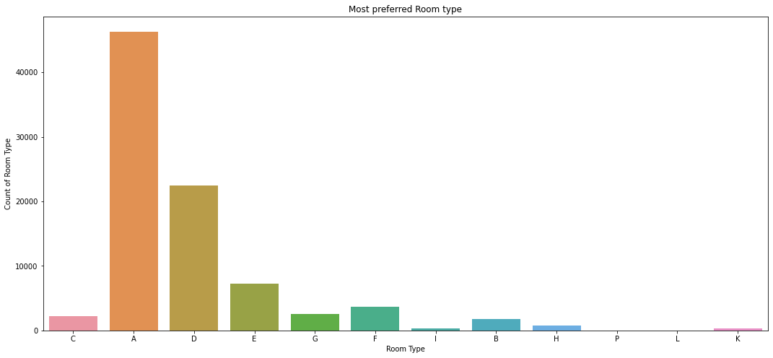
Observation
So the most preferred Room type is "A".

Slide 25
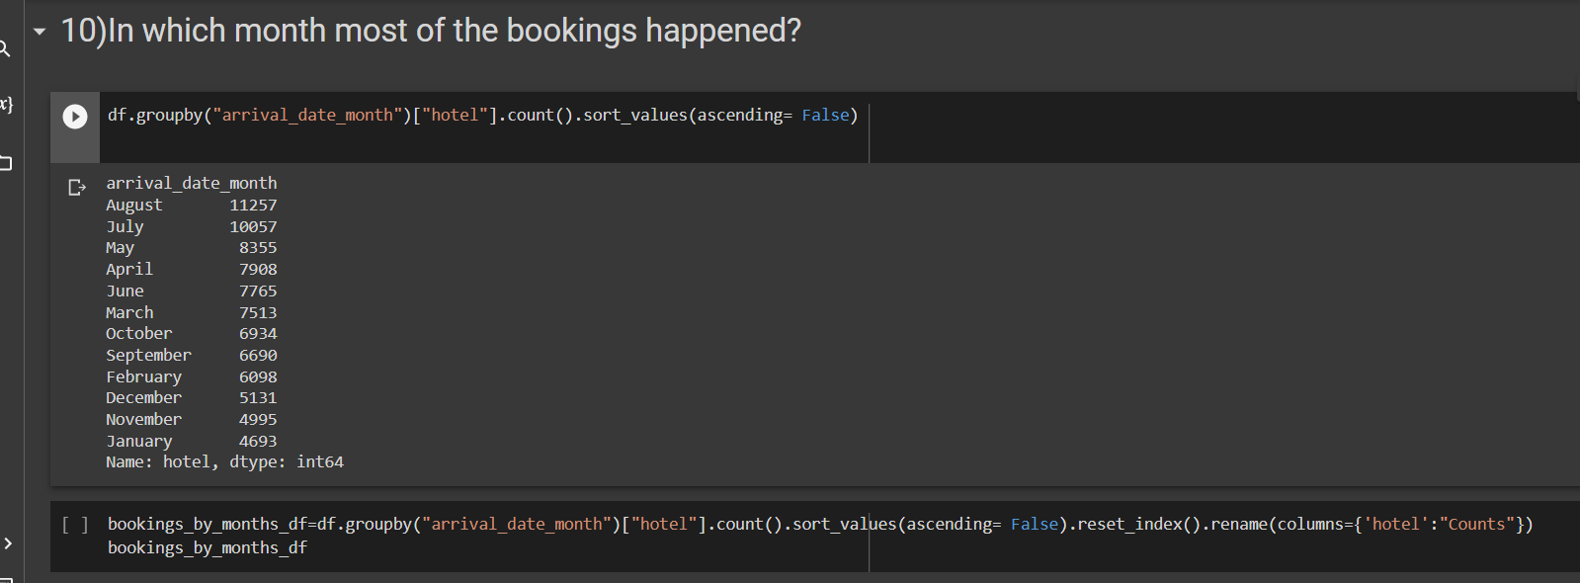
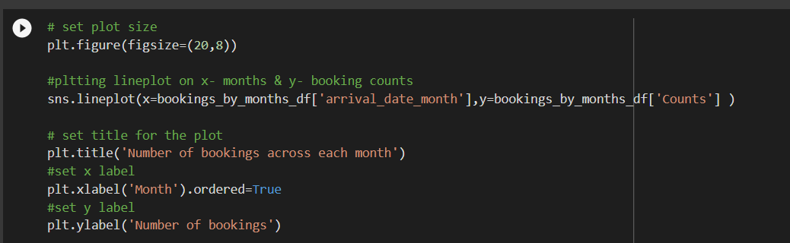

Slide 26
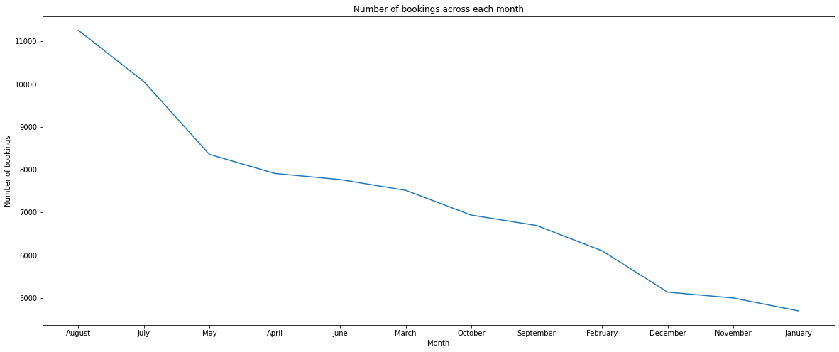
Observation
July and August months had the most Bookings. Summer vacation can be the reason for the bookings

Slide 27
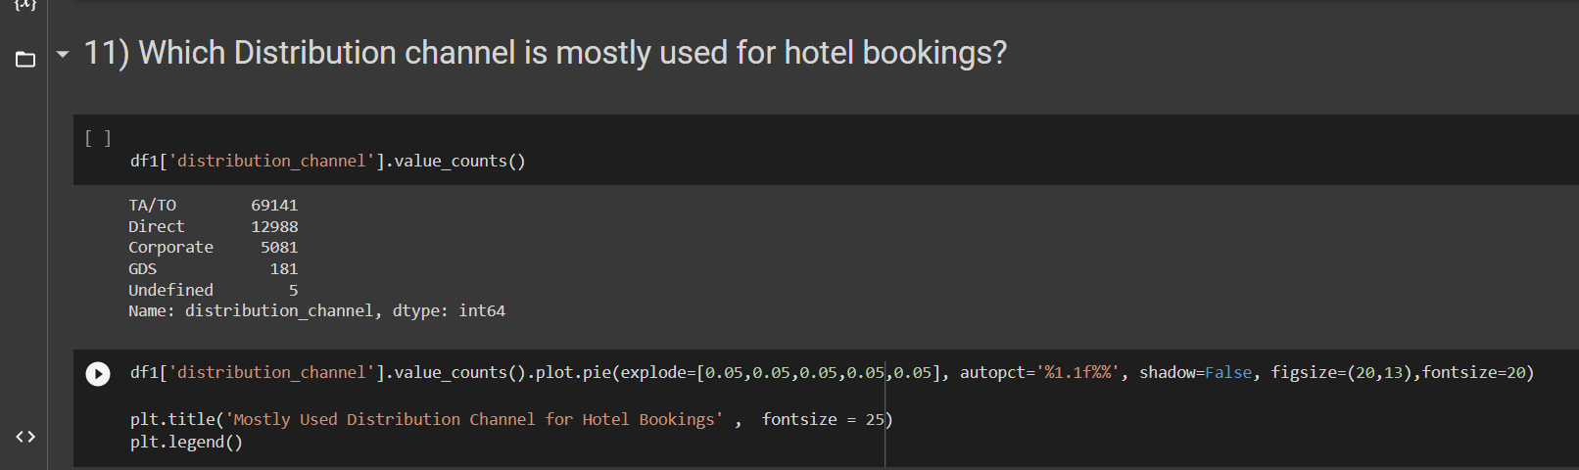
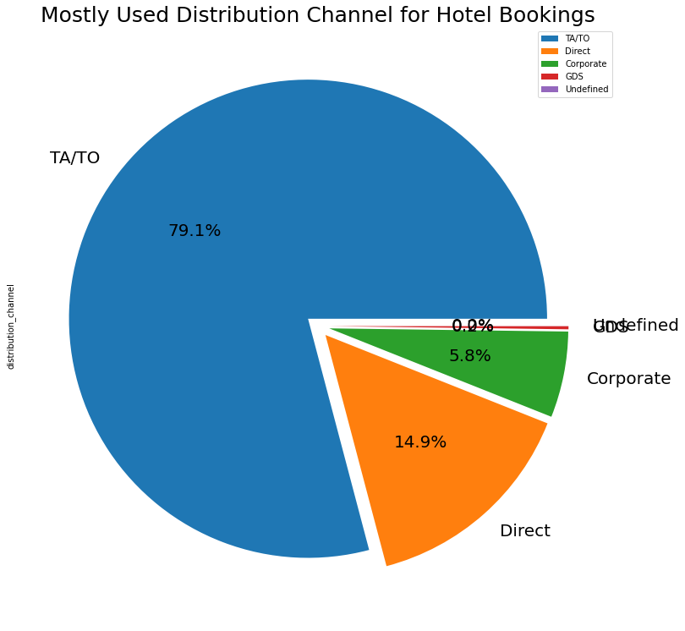
Observation:
'TA/TO' is mostly(79.1%) used for booking hotels

Slide 28
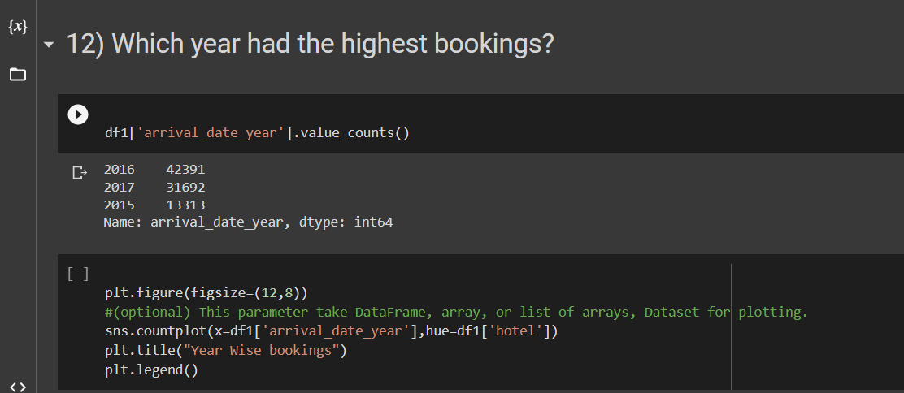
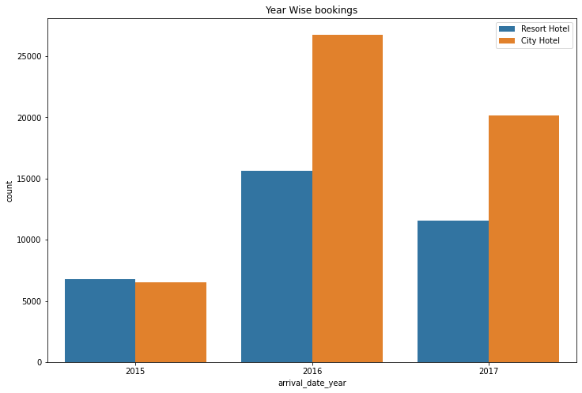
Observation
2016 had the highest bookings.
2015 had less 7000 bookings.
overall City hotels had the most of the bookings

Slide 29

I Take Some Help by This sites :
stack overflow
Greeks for greeks

